Slide 1
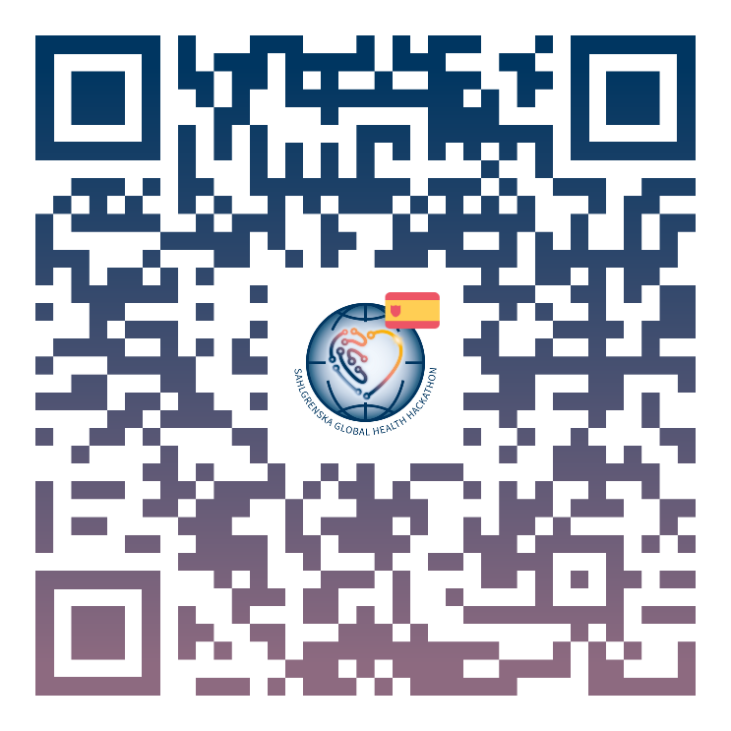
ASTRAZENECA PROUDLY SUPPORTS
SAHLGRENSKA GLOBAL HEALTH HACKATHON
Gothenburg, Stockholm
& Malmö. Sweden. Feb 1-2.
Choose one of five global health challenges:
Health equality & access to care
F*@# Cancer
Healthy ageing
Infection prevention & control
Smart, safe & sustainable healthcare
Barcelona
Spain. Feb 22-23.
Boston & Miami
USA. April 5-6.
London
UK. May 10-11.
Göttingen
Germany. May 24-25.
Singapore
July 5-6.
We welcome participants from all backgrounds. Coding experience is not required.

Slide 2
ASTRAZENECA PROUDLY SUPPORTS
SAHLGRENSKA GLOBAL HEALTH HACKATHON
Challenge areas:
Sign-up now!
Health equality & access to care
F*@# Cancer
Healthy ageing
Infection prevention & control
Smart, safe & sustainable healthcare
Co-action to address global health challenges.

